Slide 1
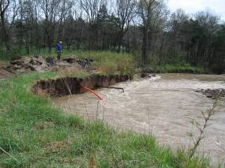
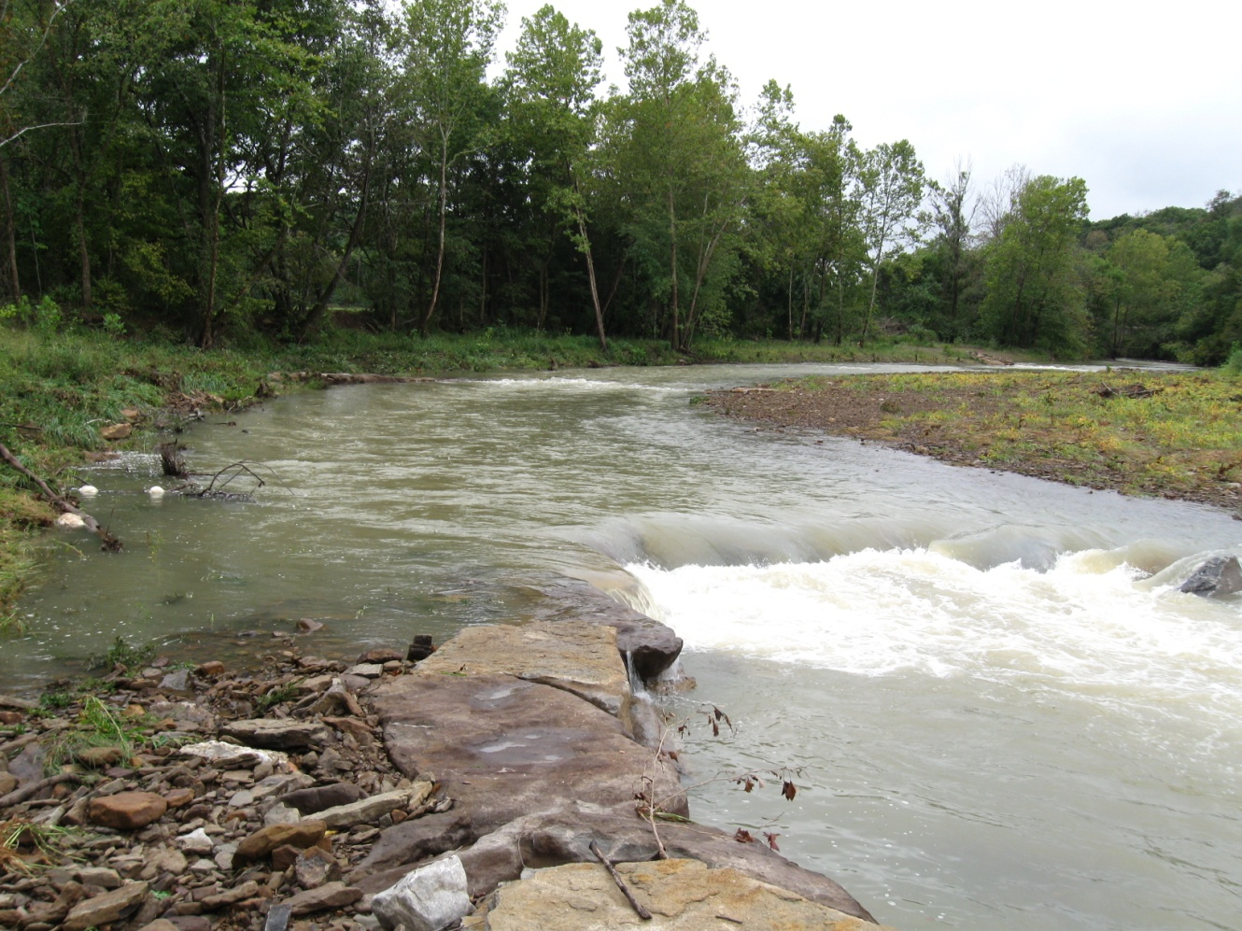
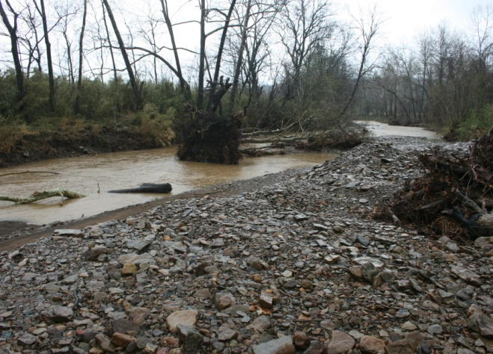
West Fork White River
Stream Restoration Project Update
Watershed Conservation Resource Center
Arkansas Game and Fish Commission, Beaver Water District, Northwest Arkansas Land Trust, Arkansas Natural Resources Commission, Environmental Protection Agency

Slide 2
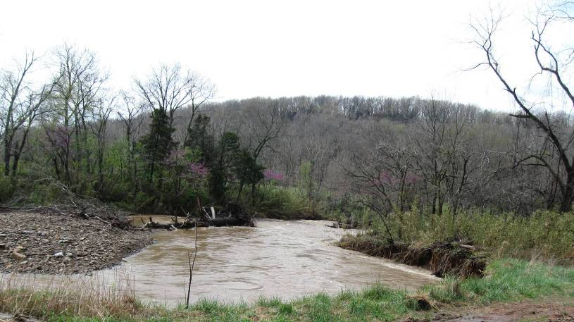
Project Goal
Demonstrate an rural stream restoration using a natural channel design approach

Slide 3
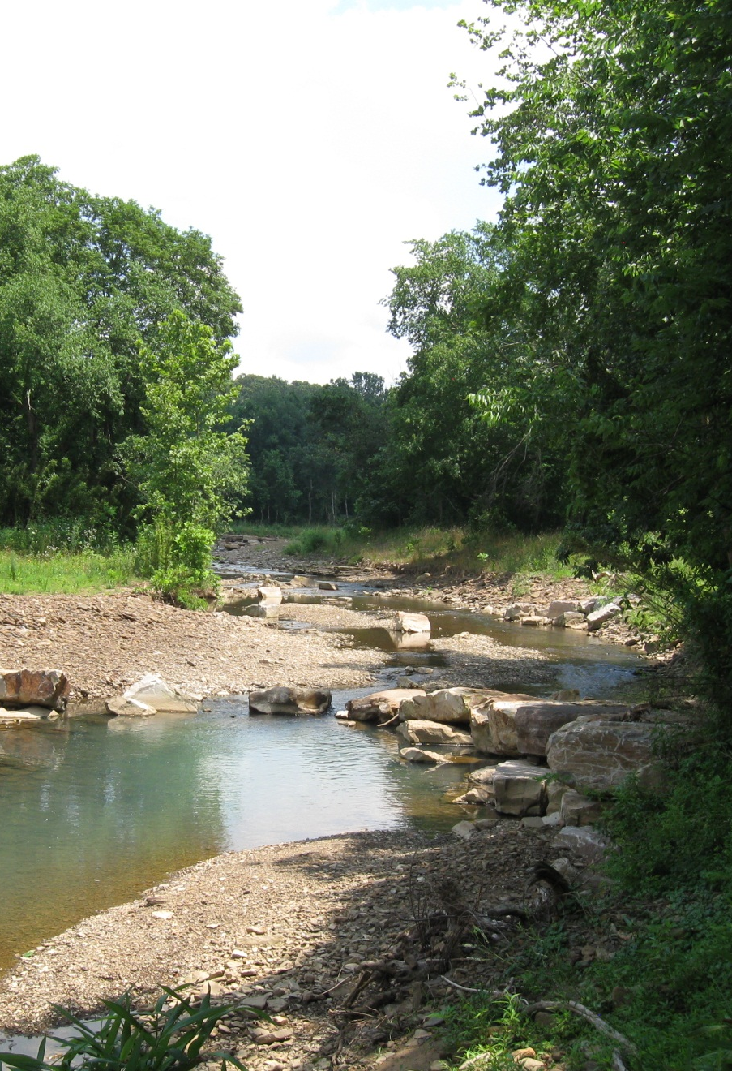
Project Partners
Arkansas Game and Fish Commission
Beaver Water District
Northwest Arkansas Land Trust
Elk River Construction
Arkansas Natural Resources Commission
US EPA, Region VI
Watershed Conservation Resource Center

Slide 4
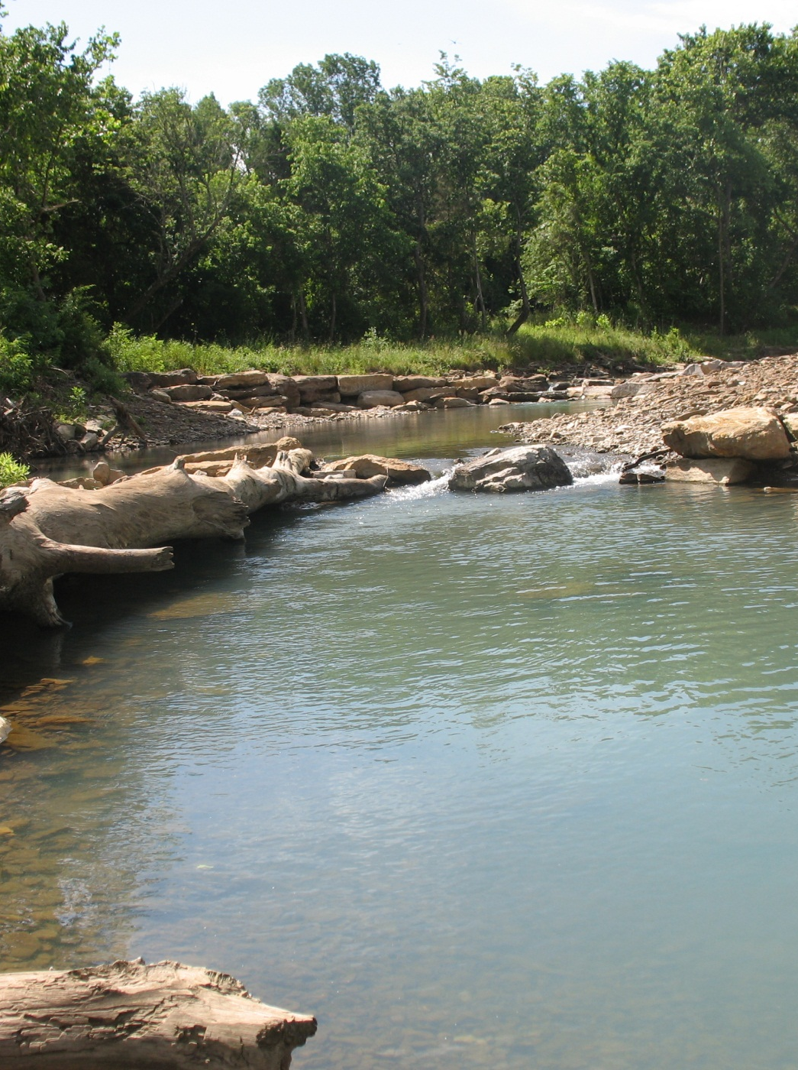
Project Objectives
Utilize reference or stable stream reaches to assist in restoration design
Reduce streambank erosion
Quantify sediment reduction
Improve aquatic habitat
Increase pollutant removal potential
Improve local ecology
Transfer technology

Slide 5
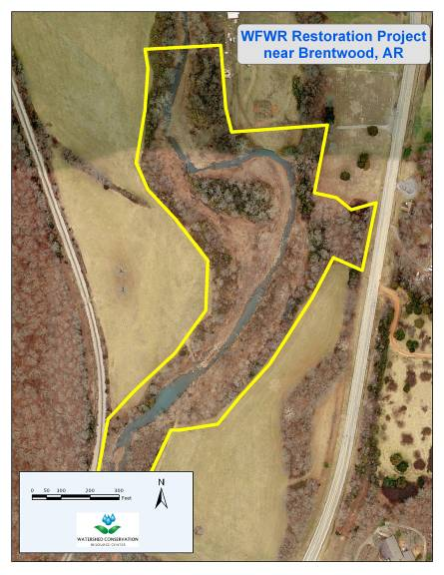
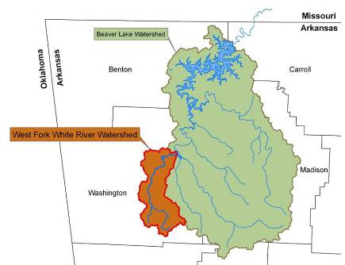
WFWR near Brentwood, AR
Drainage Area 18 mi²
Rural Watershed
  Forest
  Pasture
~1,800’ of Stream Channel
Rosgen C4/1-Type Stream
3 Landowners

Slide 6
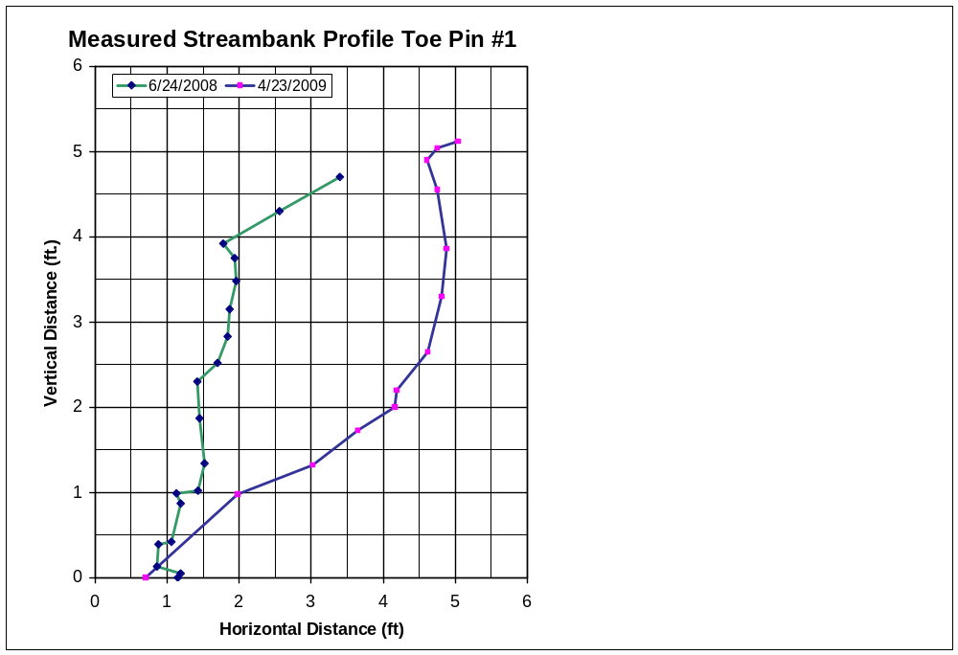
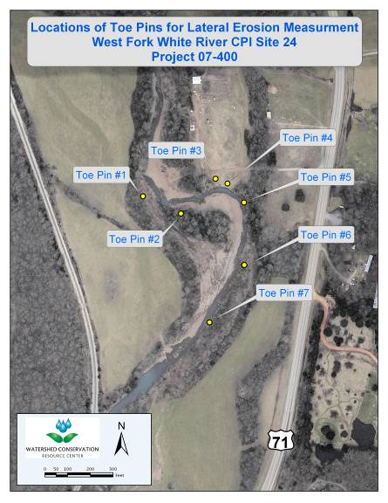
Pre-Restoration Site Monitoring
Streambank Erosion Analysis
Average ΔH = 1.72’ (Toe Pin #1)

Slide 7
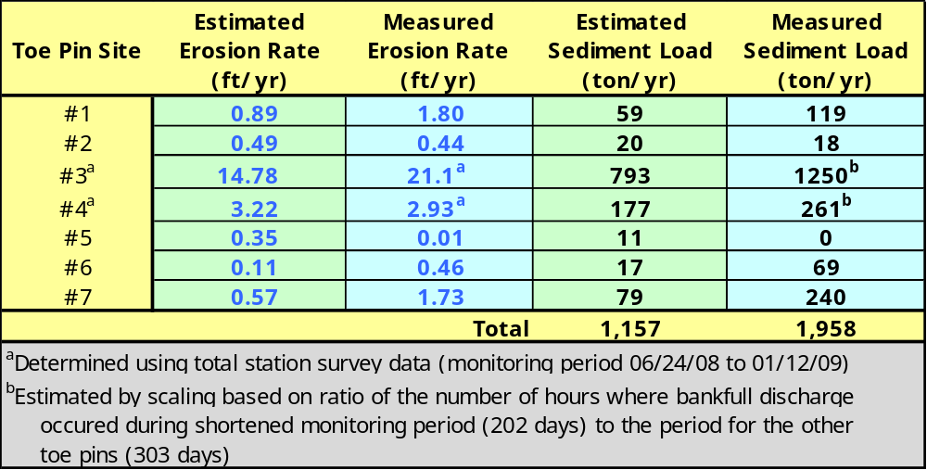
Pre-Restoration Site Monitoring
Streambank Erosion Analysis
Estimated vs. Measured Erosion Rates
There were only 22 hours where bankfull discharge or greater occurred at the WFWR gage station during the monitoring period. The average number of hours per year at the gage is approximately 48

Slide 8
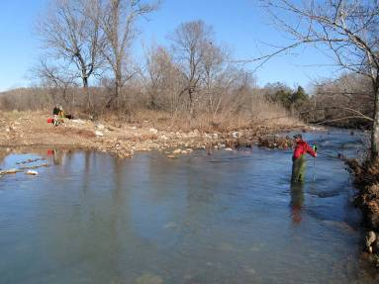
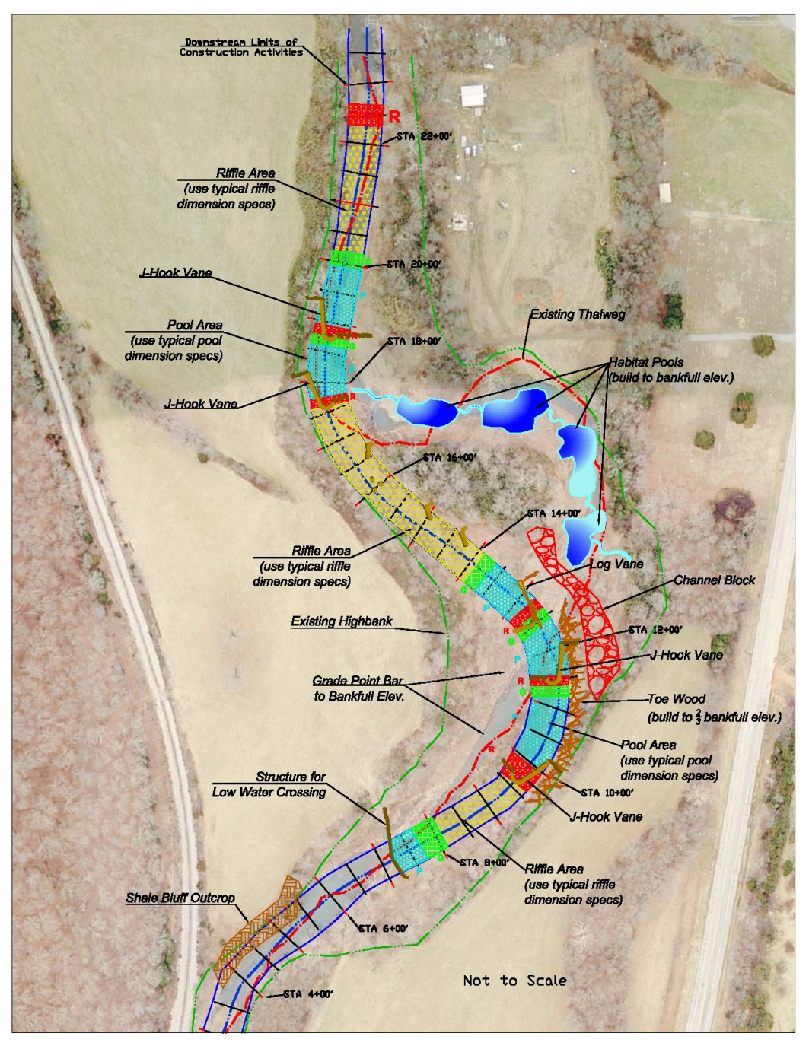
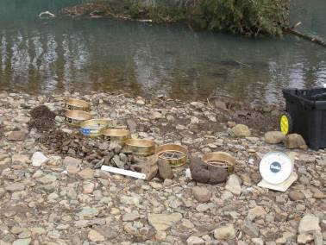
Restoration Design

Slide 9
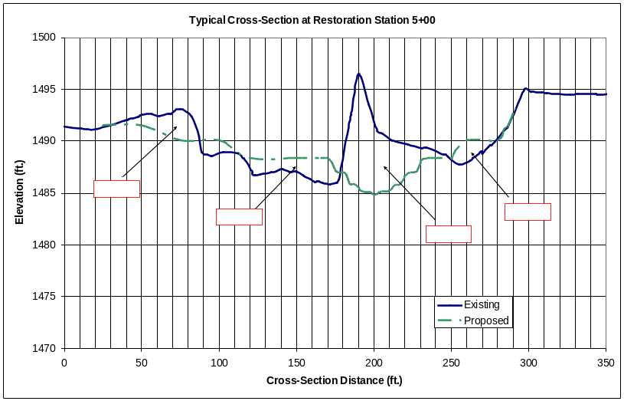
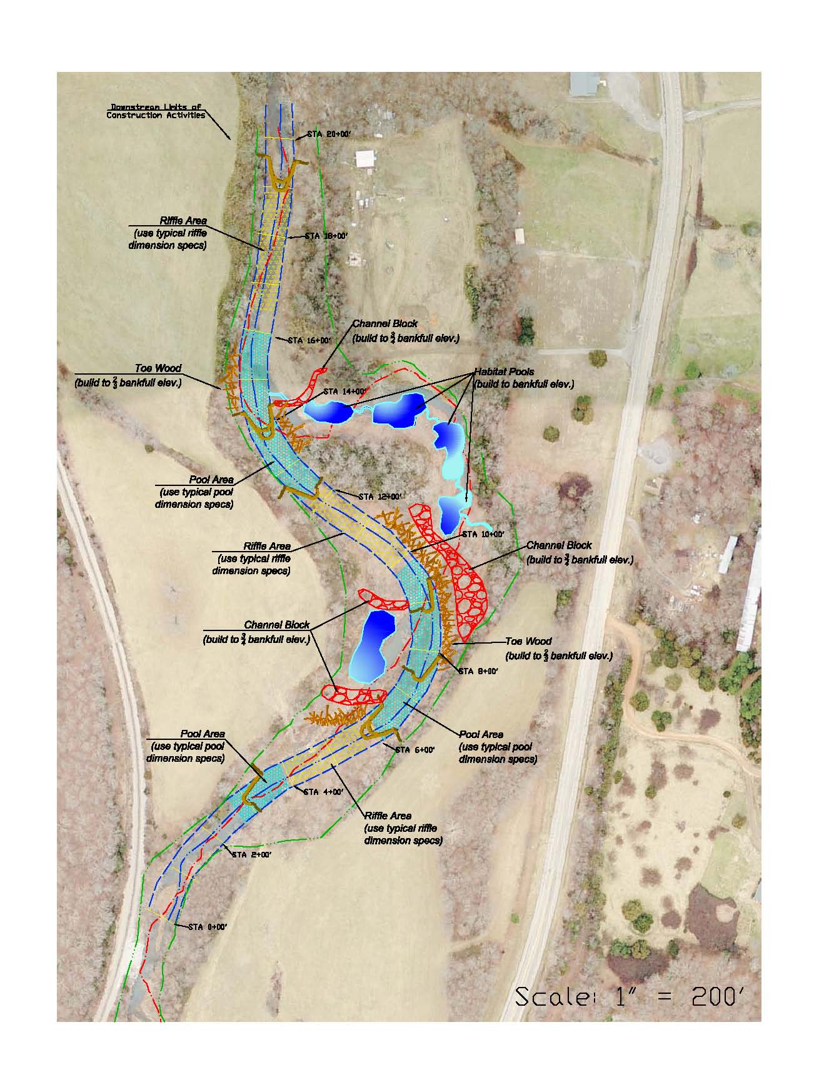
Stream Restoration Design
Detailed Data Evaluation
  Topographic Survey
  Geomorphologic Analysis
  Hydrology Analysis
40 Step Engineering Process
  Dimension, Pattern. Profile
  Flow Capacity
  Sediment Transport
Bankfull Discharge: 725 cfs
Design Cross Section: 135 ft²
Bankfull Slope: 0.0064 ft/ft
Bankfull Shear: 0.84 lb/ft²

Slide 10
Stream Restoration Design
General Design
Approach
Eliminate Tight Meander Bend Radii
Avoid Old Growth Riparian Areas
Maintain Stream Length
Create Wetlands

Slide 11
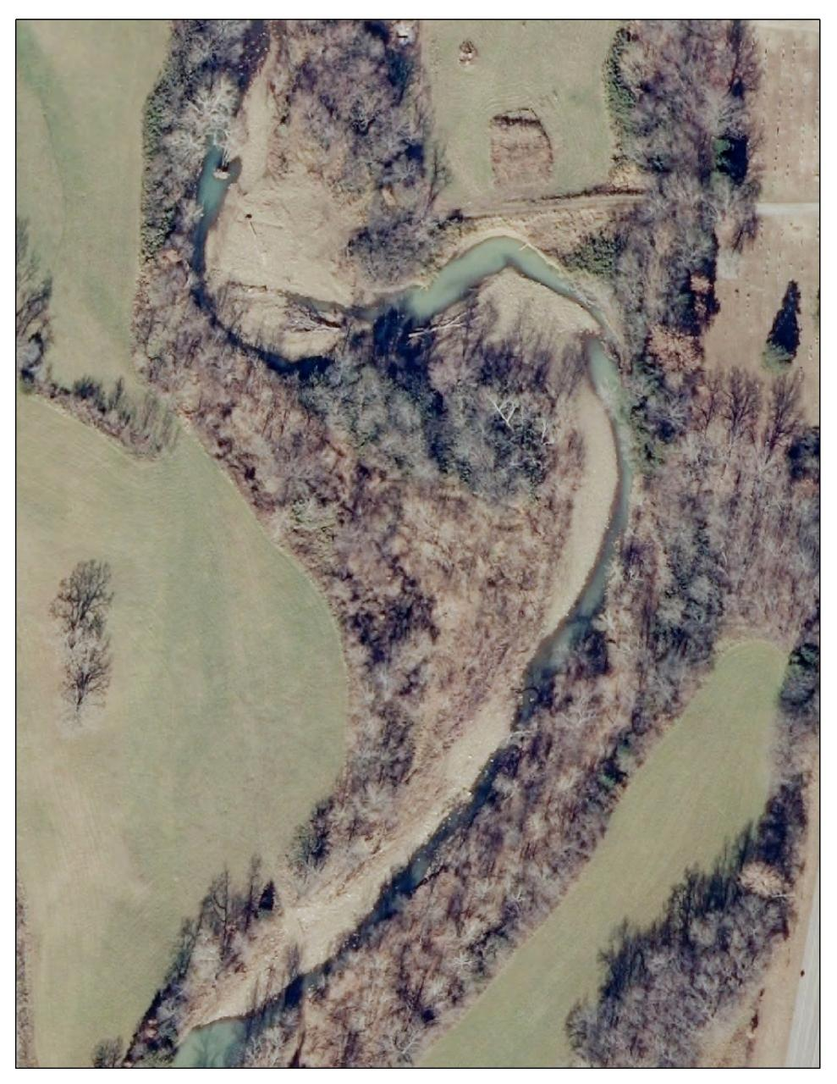
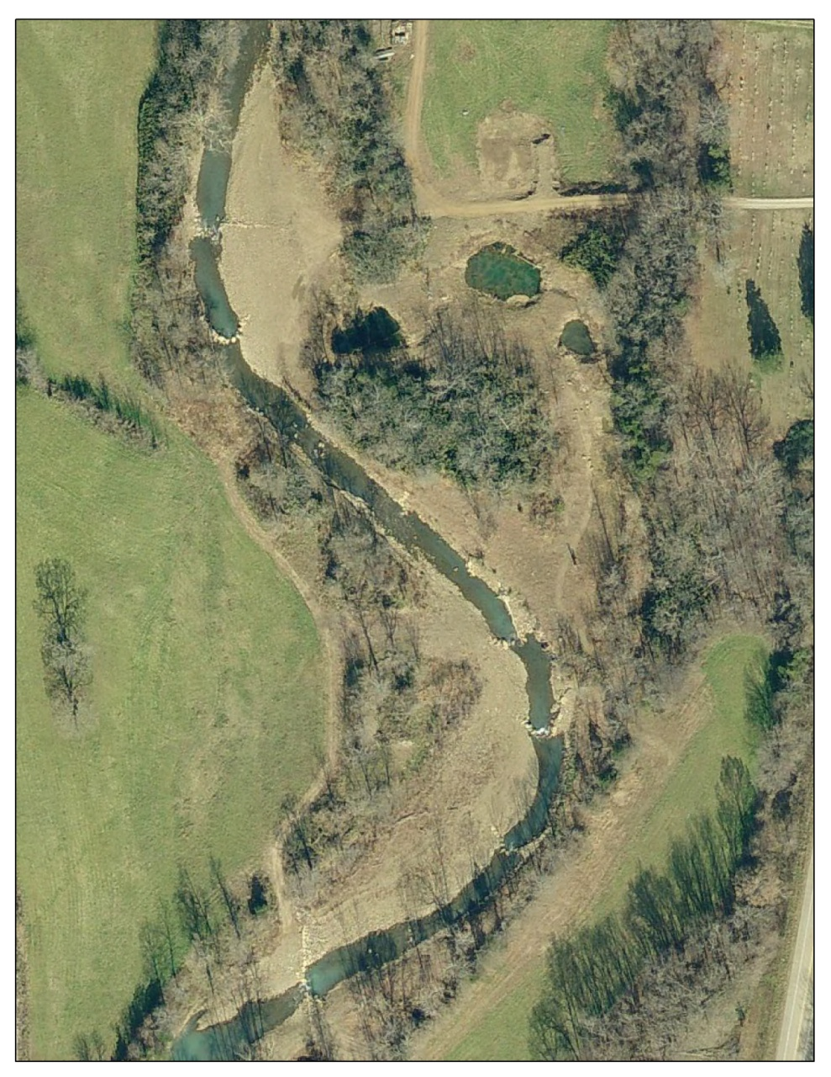
Stream Restoration Design

Slide 12
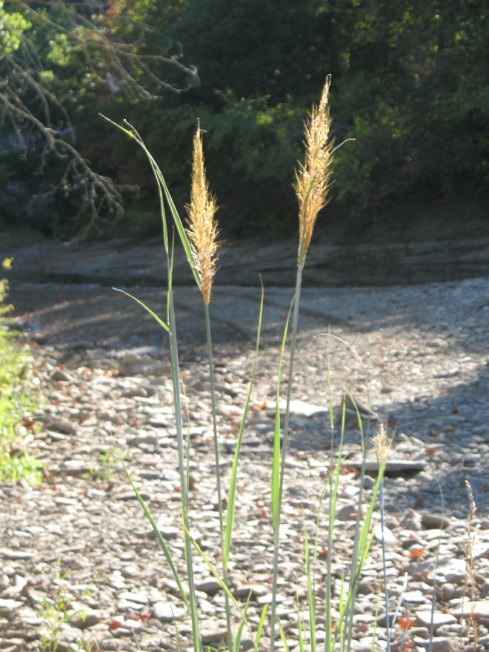
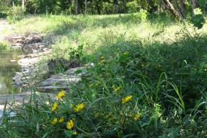
Revegetation Plan
Critical Element of the Restoration Design
  Provides Stability (high and moderate flows)
  Habitat
  Forage
  Aesthetics
Reused on-site soil and plants
Purchased plants
Consult with local specialists
Several thousand individual plants
Native Species by Sun/Water needs
  Inland Sea Oats, Wetland Grass Mix
  Button Bush, Spice Bush
  Alder, Witch Hazel, River Birch, Sycamore
Irrigation throughout 1st summer and during dry periods of 2nd summer

Slide 13
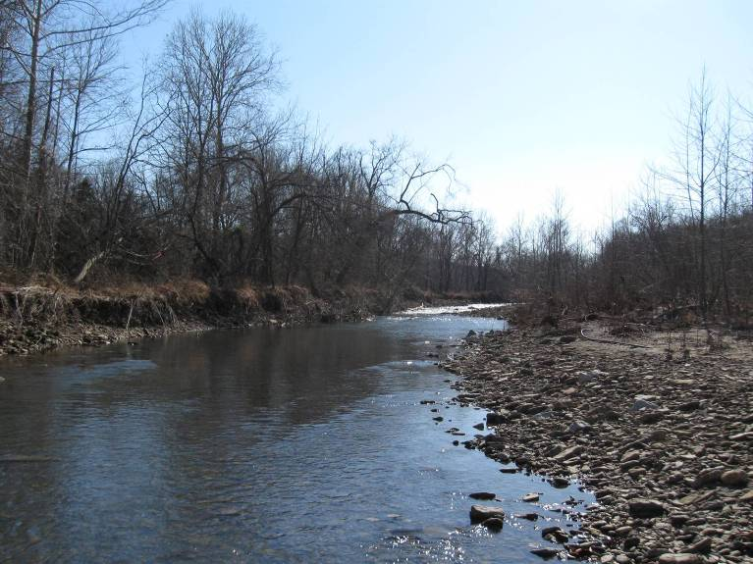
Site Photos
Before Restoration (upstream)

Slide 14
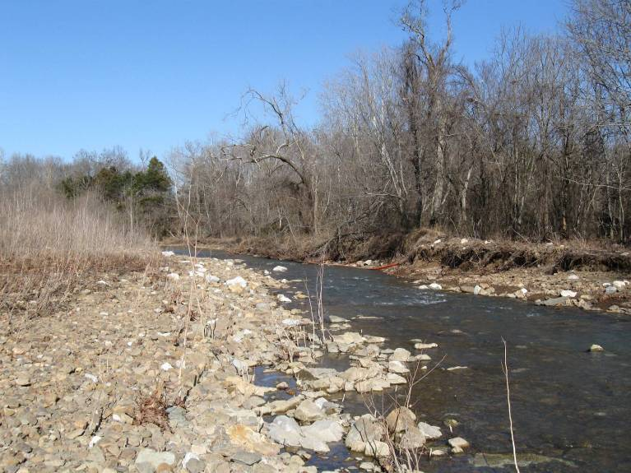
Site Photos
Before Restoration (upstream)

Slide 15
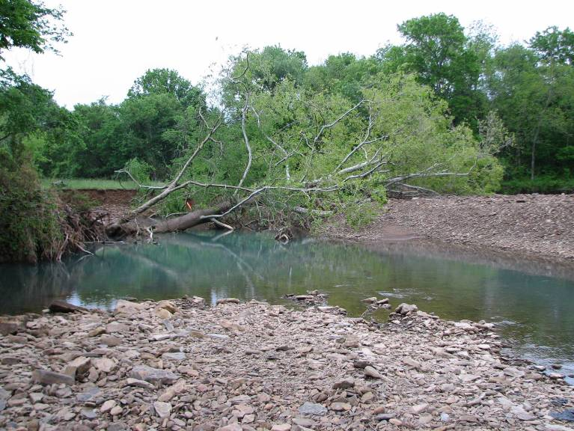
Site Photos
Before Restoration (mid-section)

Slide 16
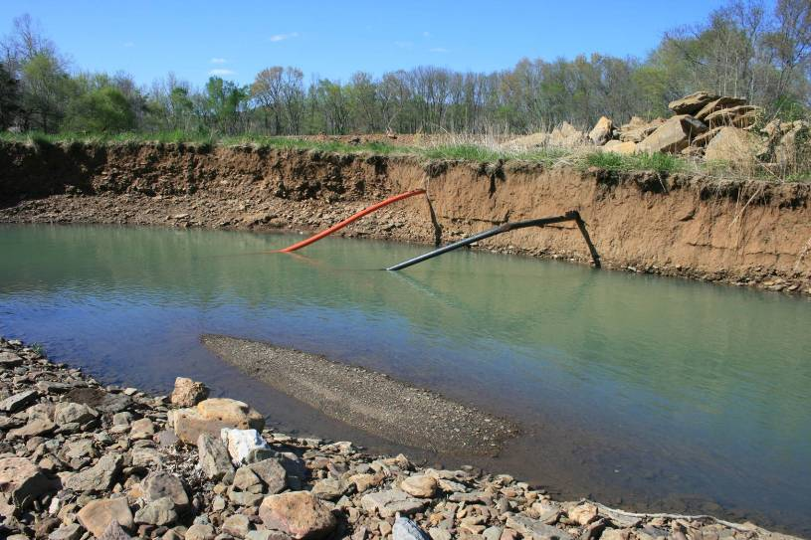
Site Photos
Before Restoration (mid-section)

Slide 17
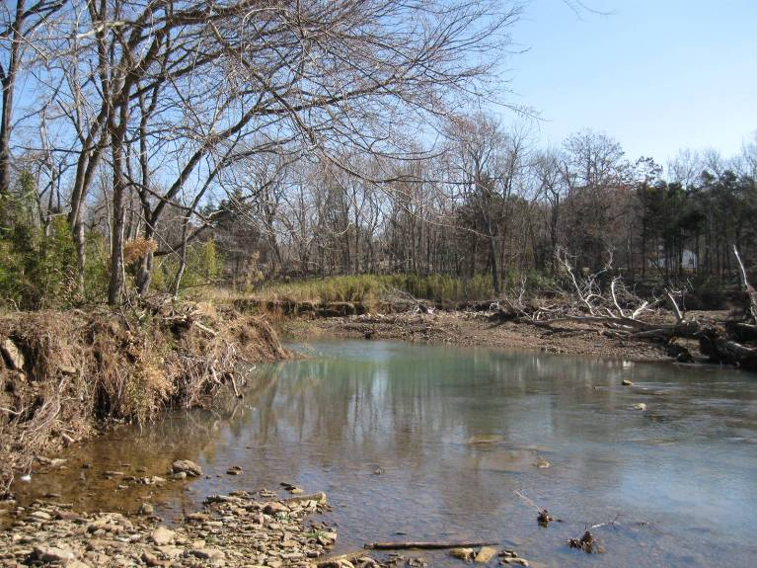
Site Photos
Before Restoration (mid-section)

Slide 18
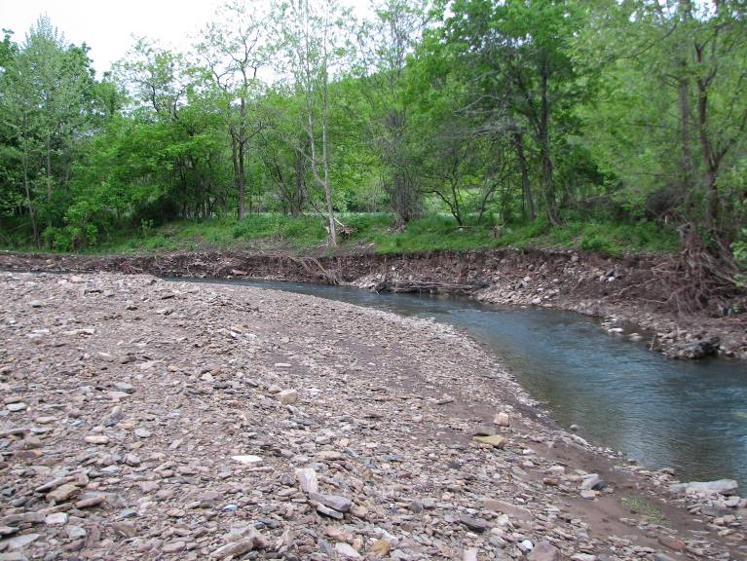
Site Photos
Before Restoration (downstream)

Slide 19

Site Photos
Before Restoration (downstream)

Slide 20
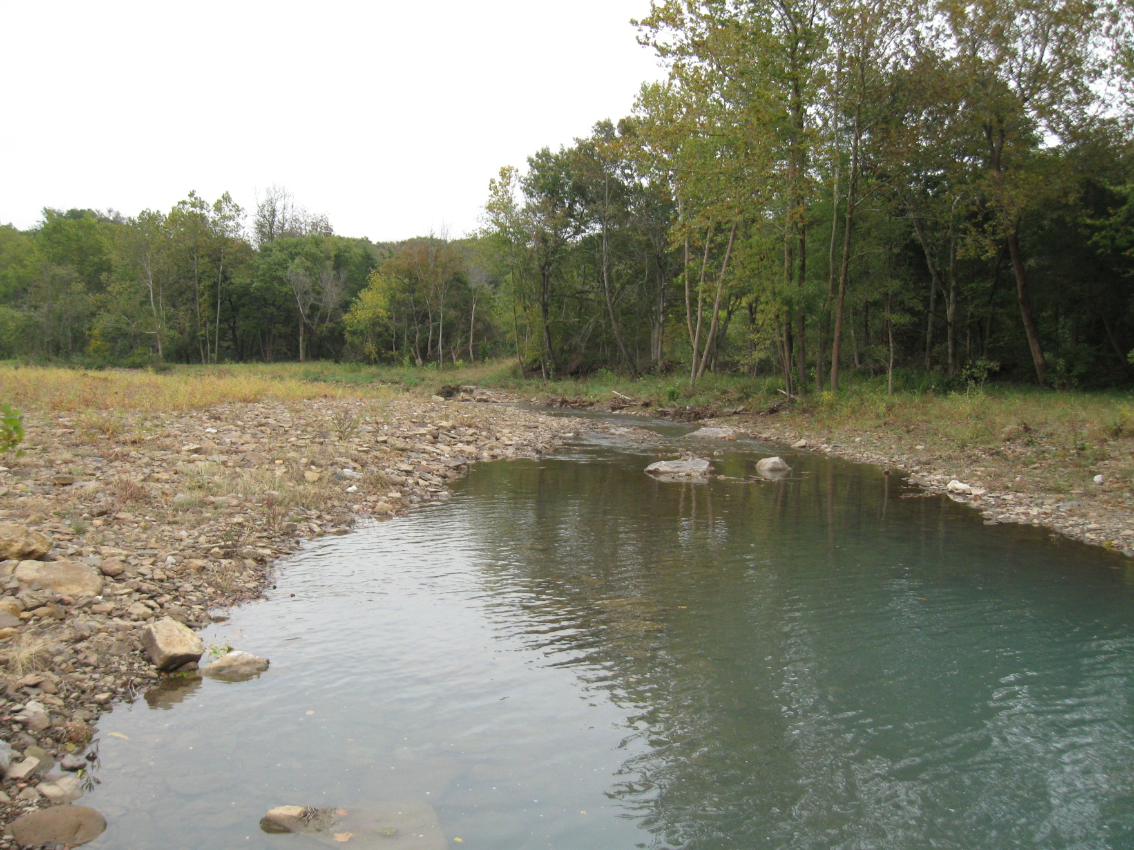
Site Photos
After Restoration (upstream)

Slide 21
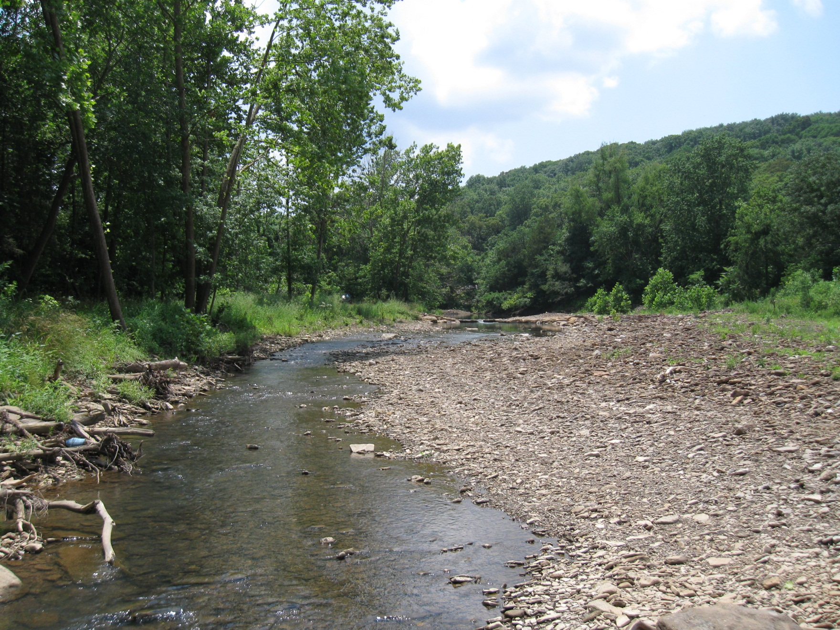
Site Photos
After Restoration (upstream)

Slide 22
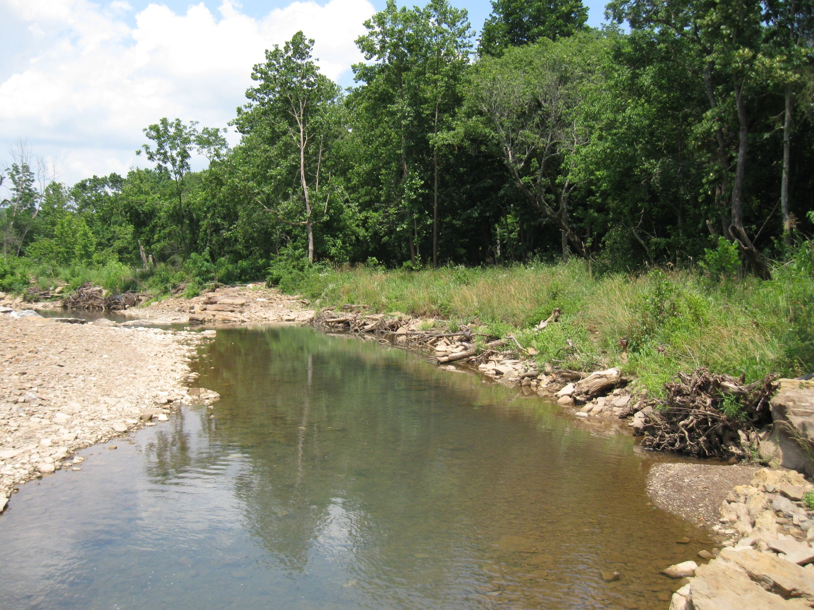
Site Photos
After Restoration (upstream)

Slide 23
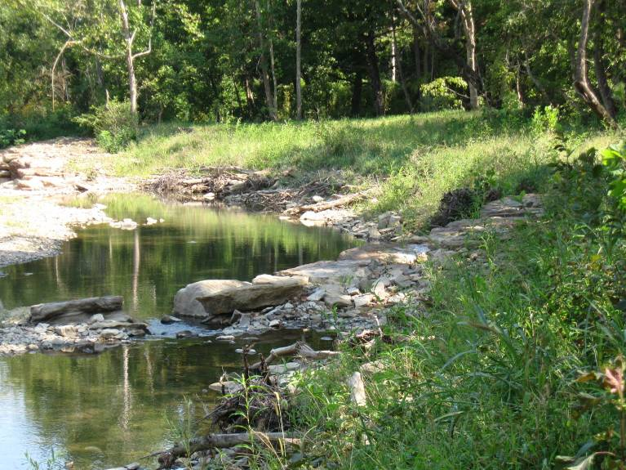
Site Photos
After Restoration (upstream)

Slide 24
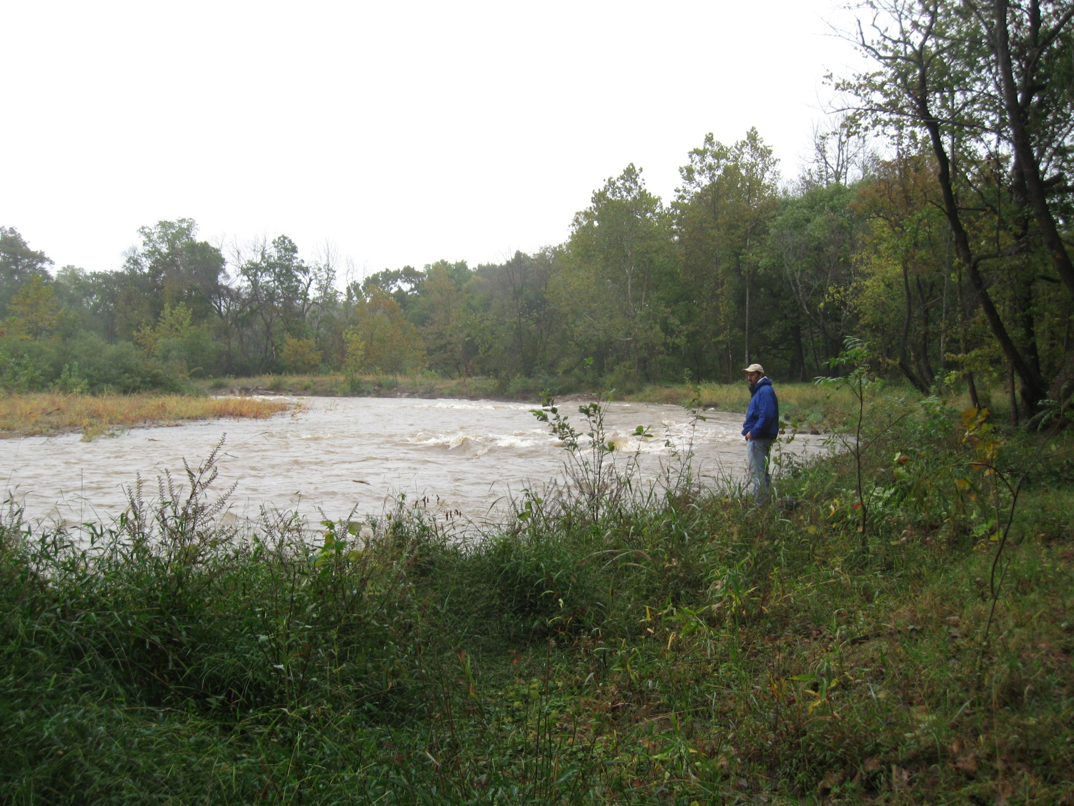
Site Photos
After Restoration (upstream)

Slide 25
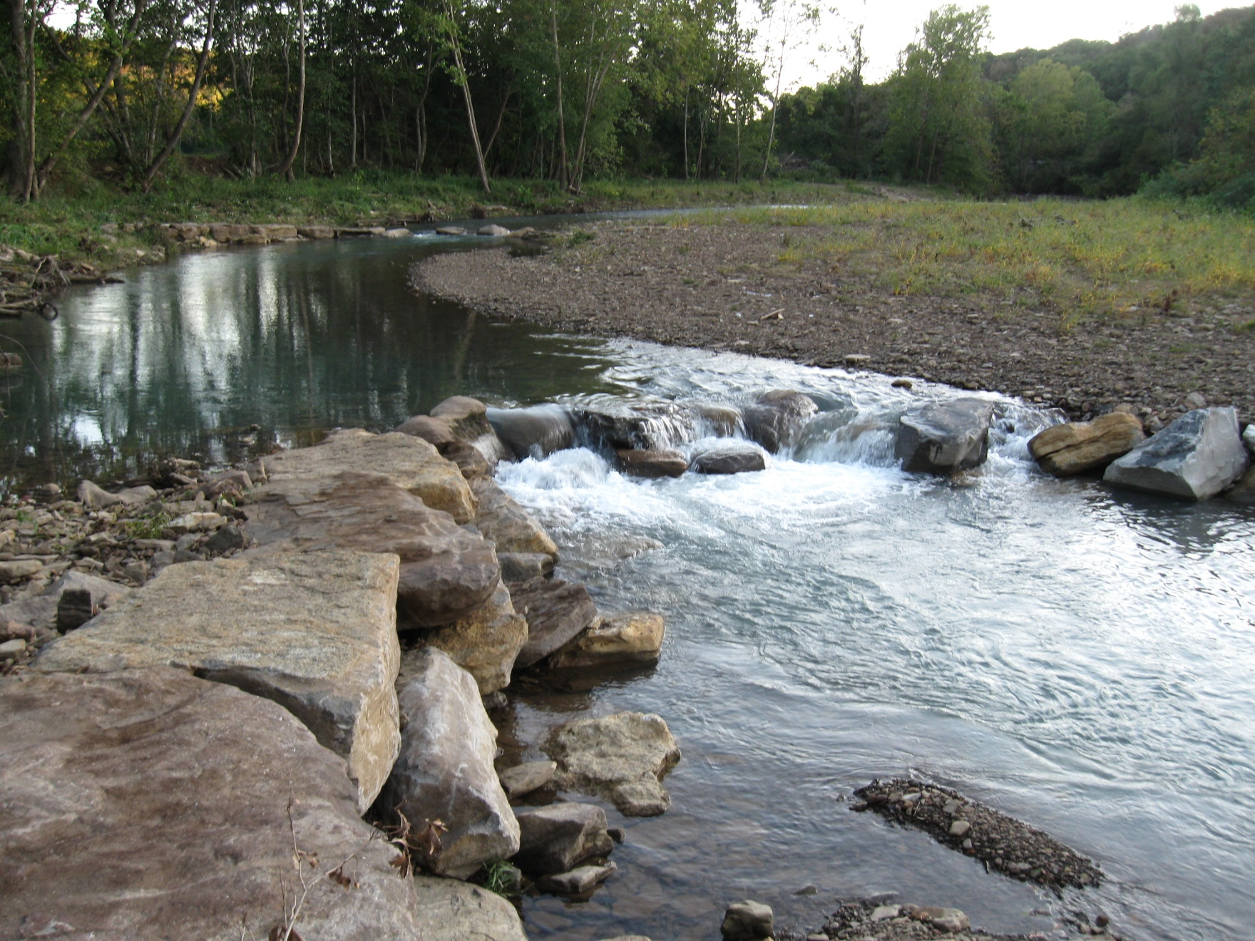
Site Photos
After Restoration (mid-section)

Slide 26
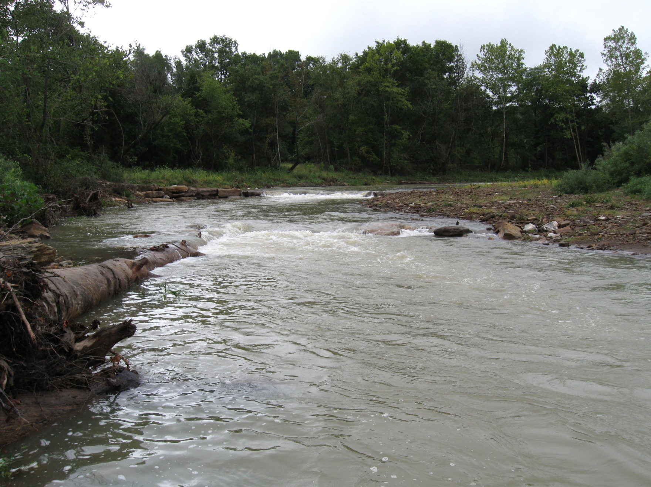
Site Photos
After Restoration (mid-section)

Slide 27
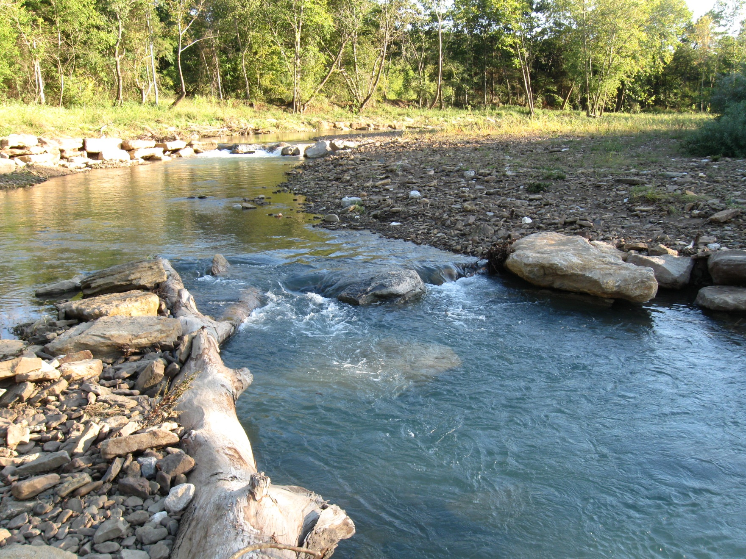
Site Photos
After Restoration (mid-section)

Slide 28
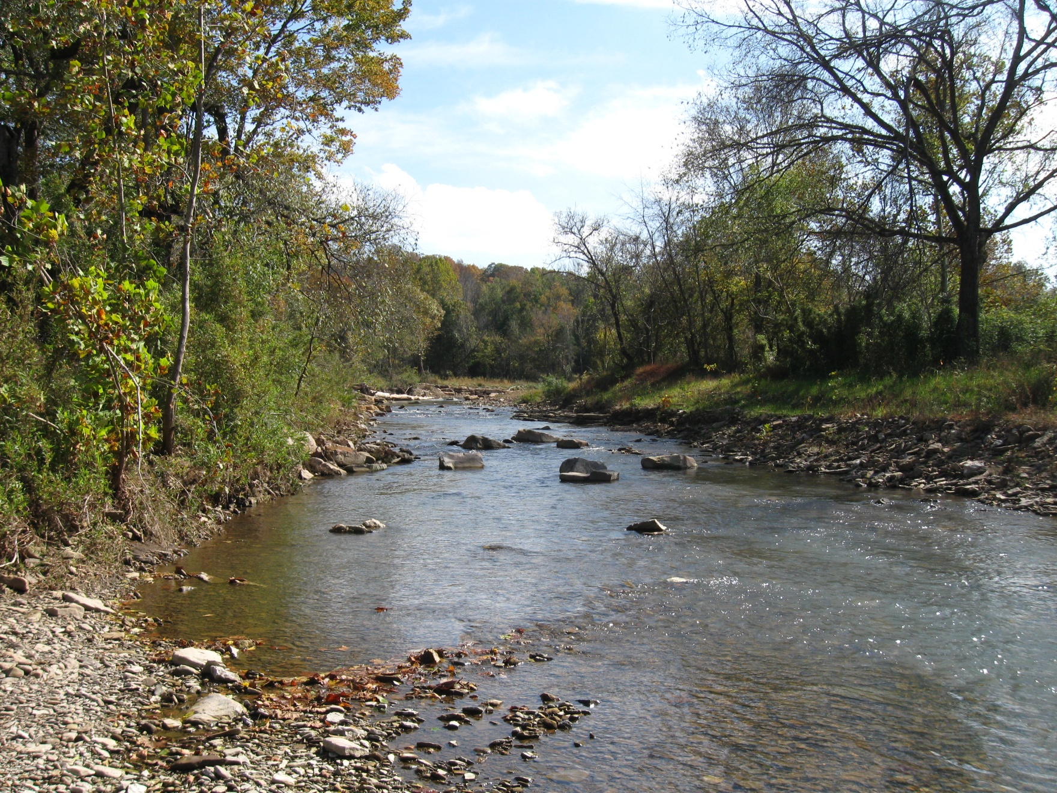
Site Photos
After Restoration (new channel)

Slide 29
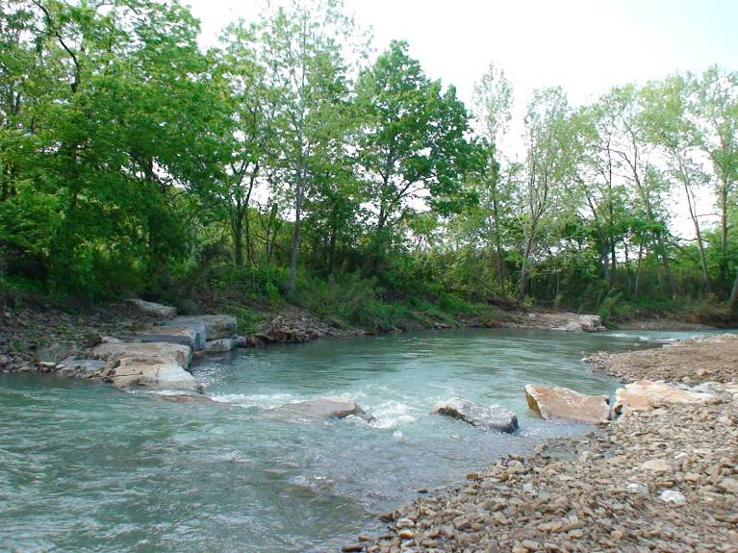
Site Photos
After Restoration (downstream)

Slide 30
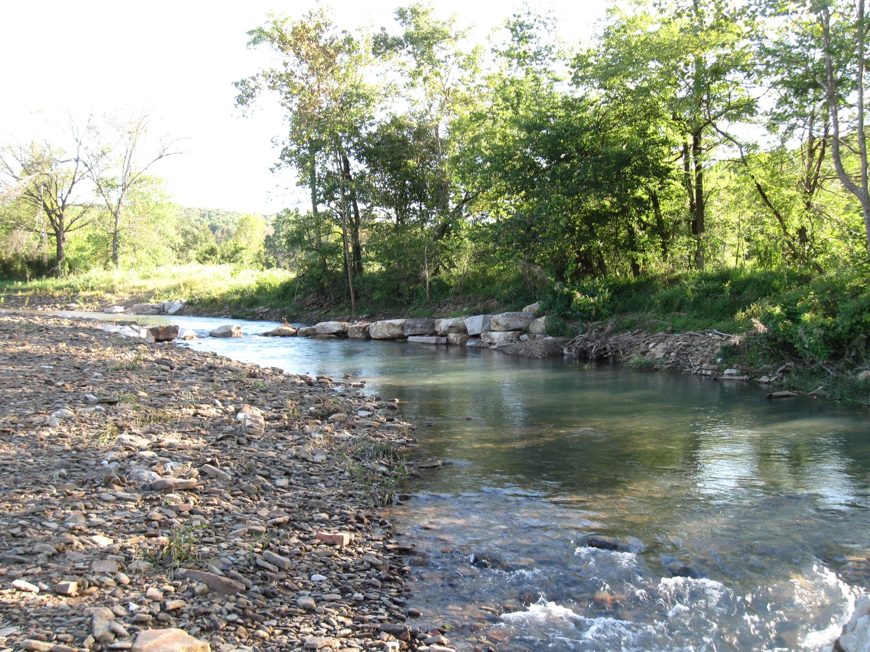
Site Photos
After Restoration (downstream)

Slide 31
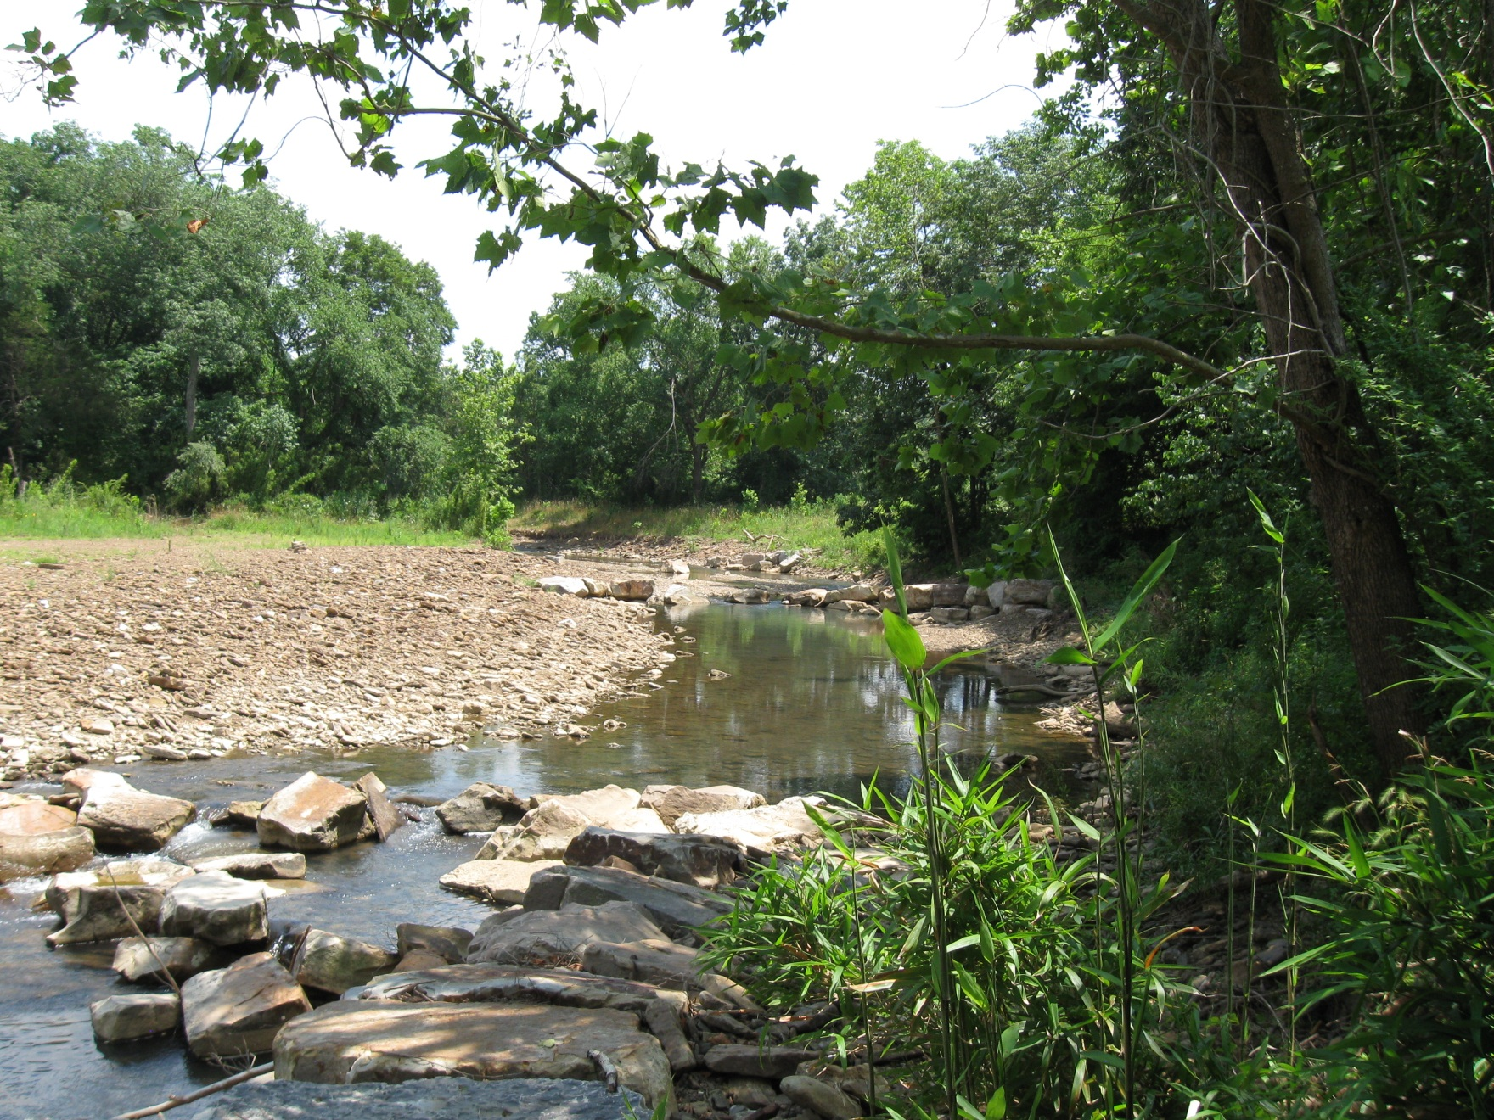
Site Photos
After Restoration (downstream)

Slide 32
Oxbow Wetland Development

Slide 33
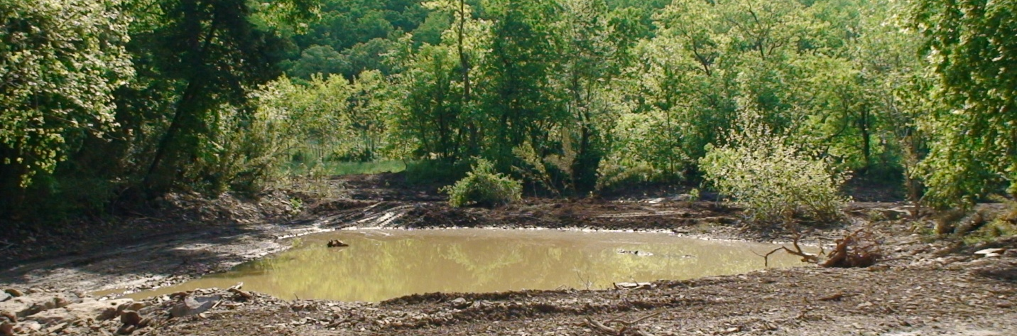
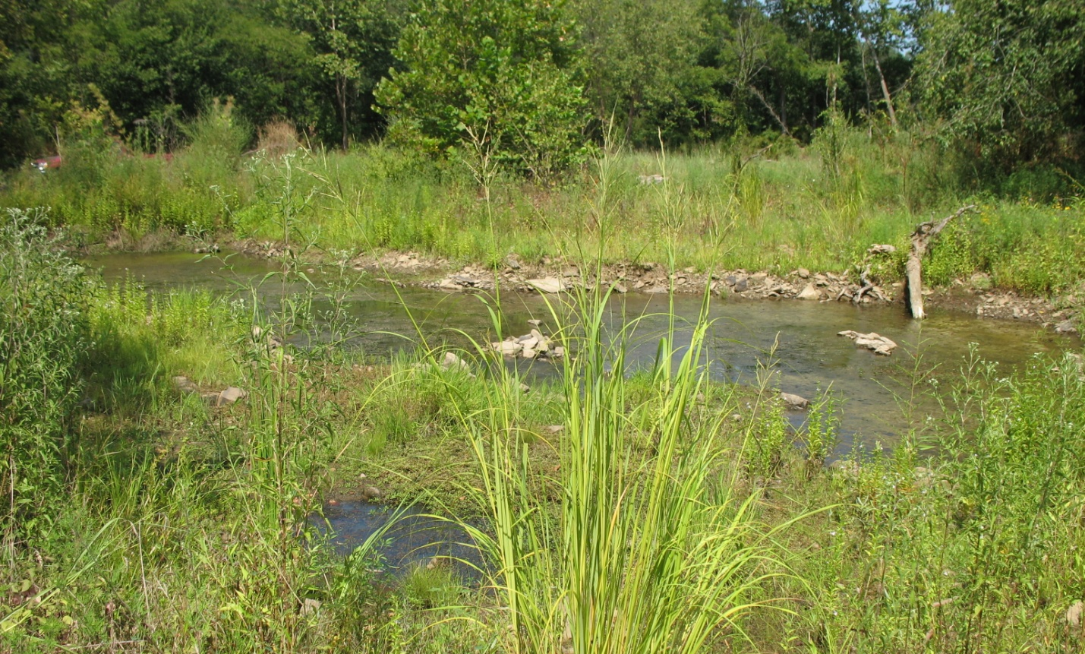
Site Photos: Constructed Wetlands

Slide 34
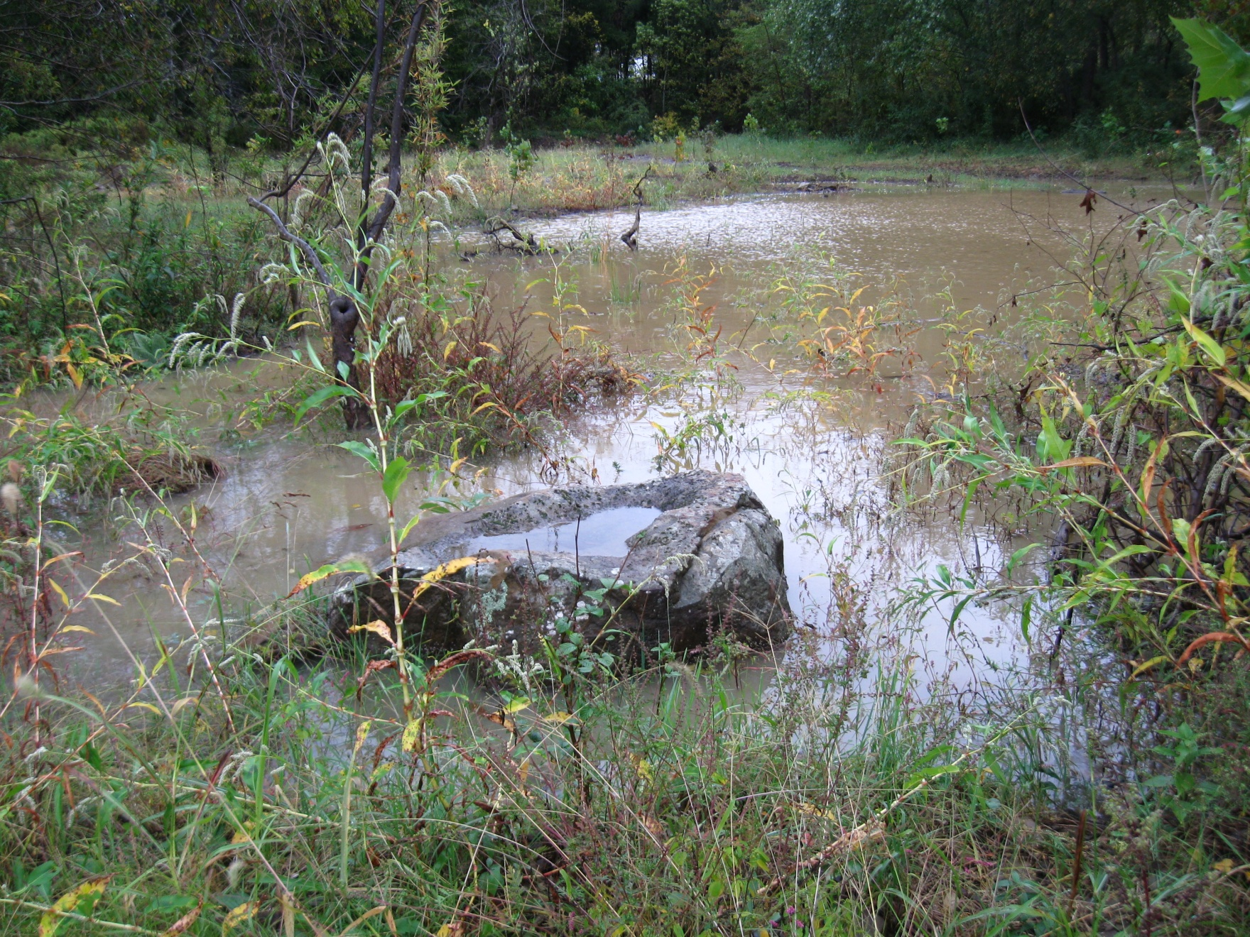
Site Photos: Constructed Wetlands

Slide 35
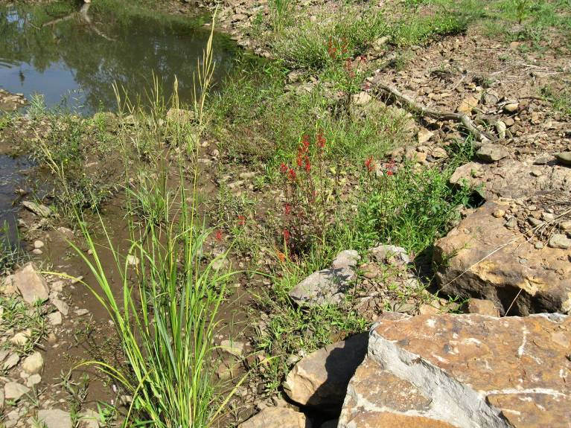
Site Photos: Constructed Wetlands

Slide 36
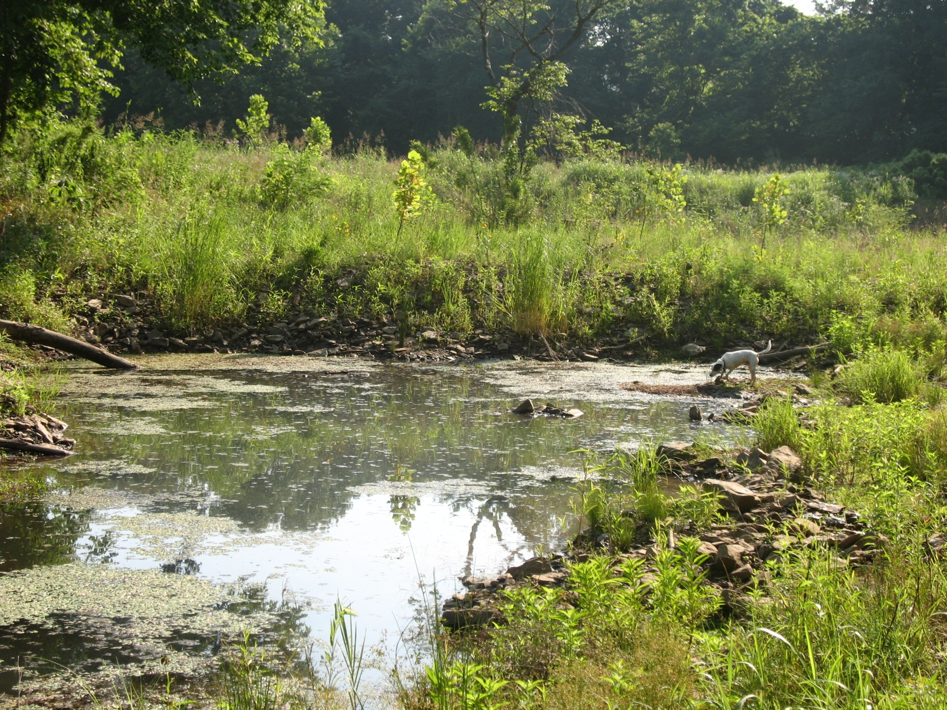
Site Photos: Constructed Wetlands

Slide 37
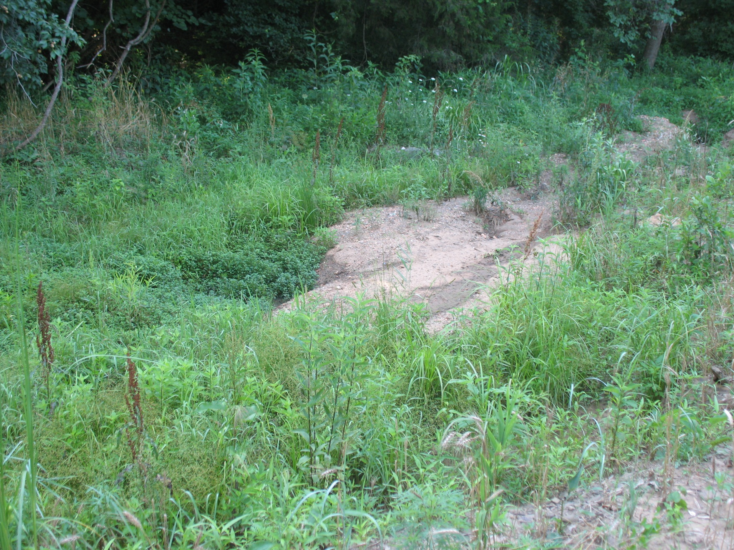
Site Photos: Constructed Wetlands

Slide 38
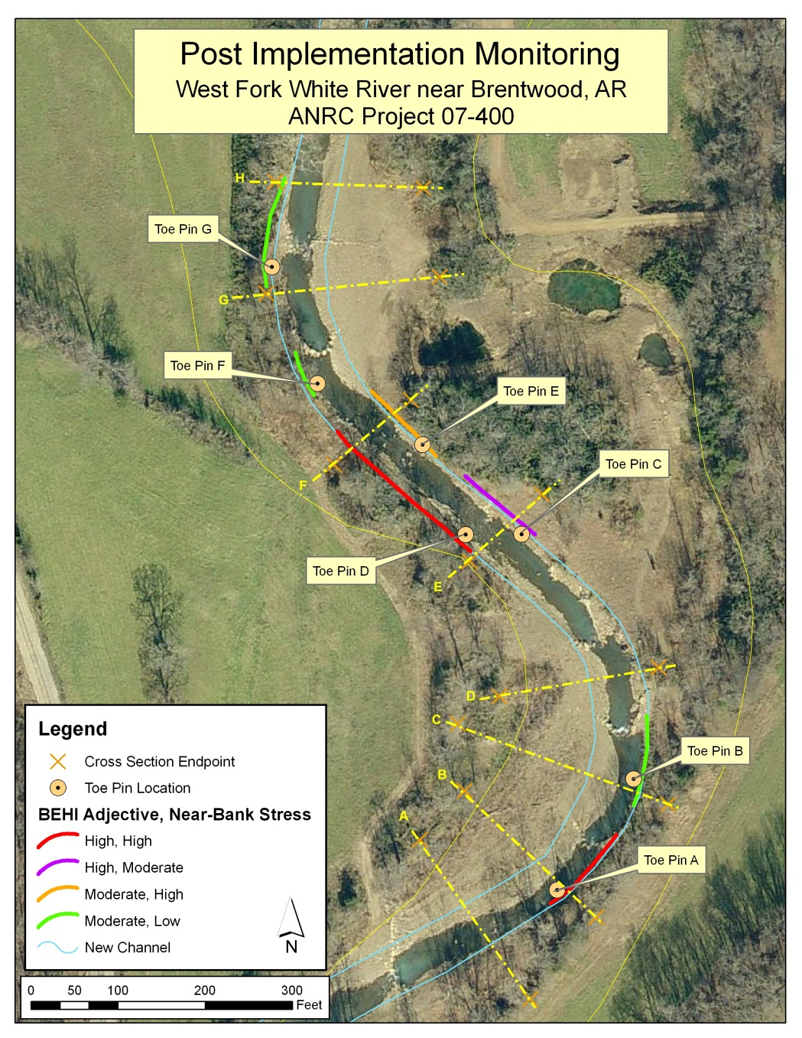
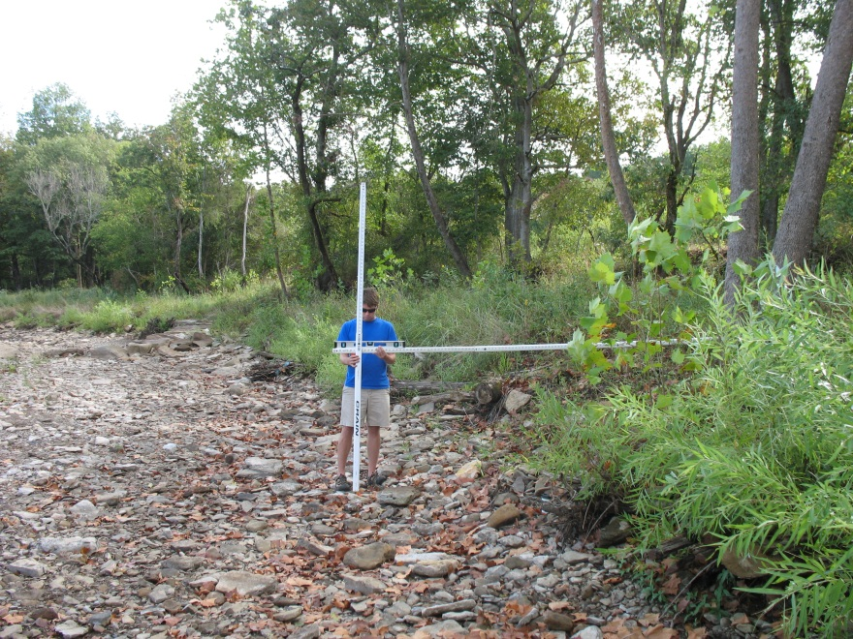
Post-Implementation Monitoring
Cross-Section Surveys
BEHI Inventory
Toe Pins

Slide 39
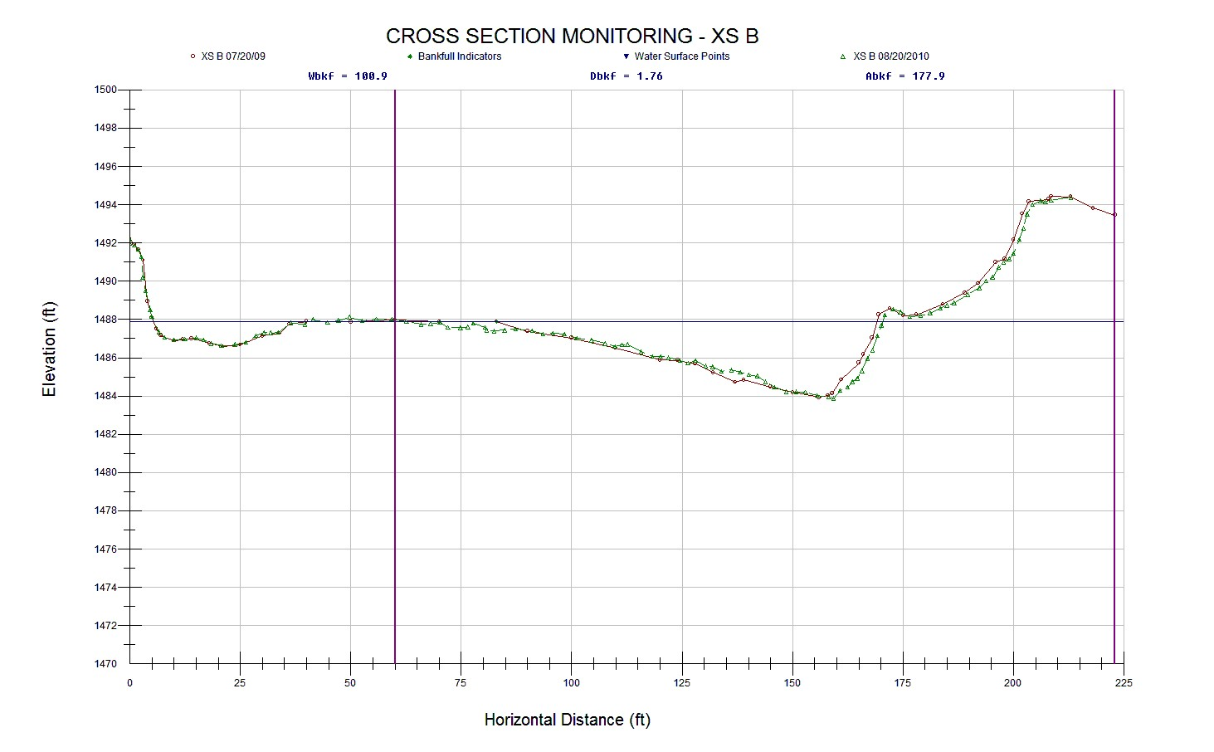
Cross-Section Surveys
Example of Cross-Section Monitoring

Slide 40
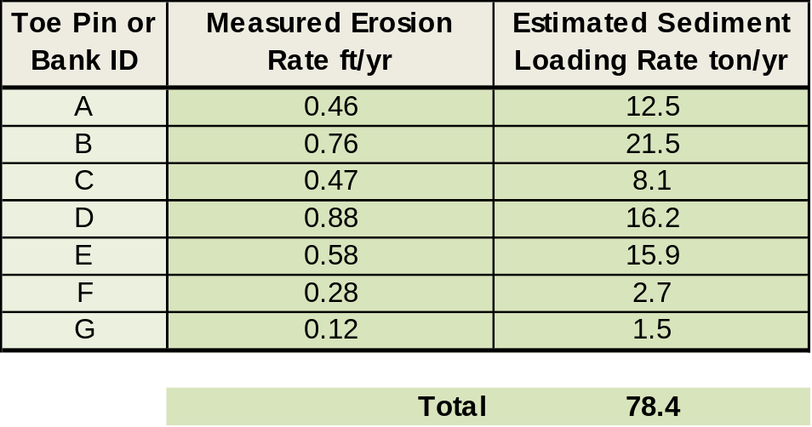
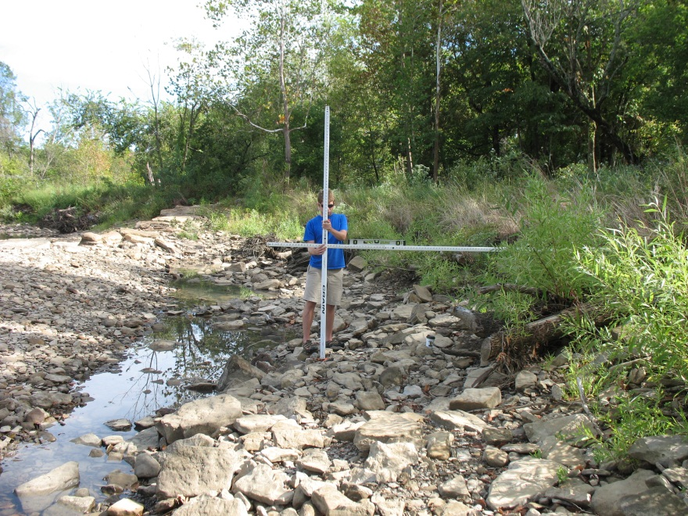
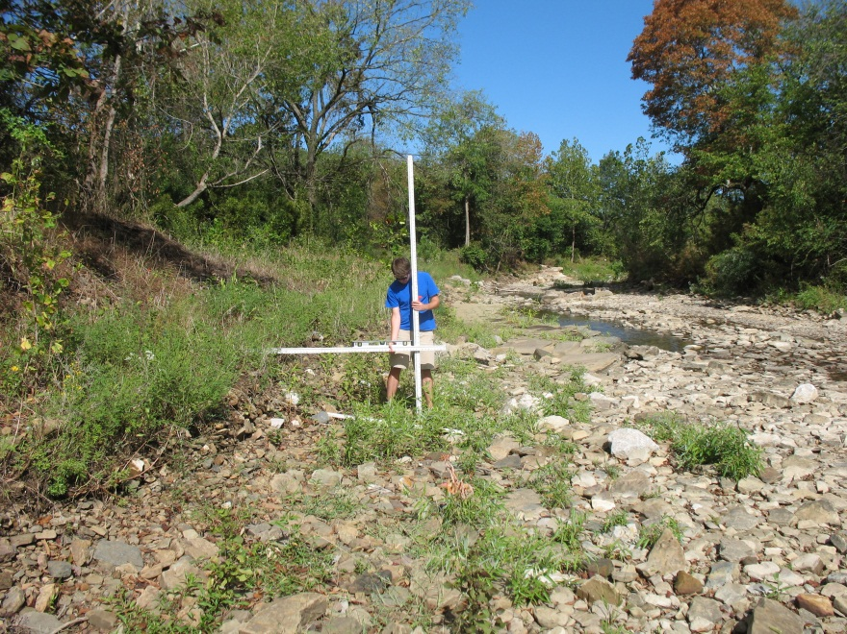
Toe Pin Monitoring
Summary of Toe Pins Measurements
Based on data from the WFWR Gage Station, there were 52 hours where bankfull discharge or greater occurred during the monitoring period. The average number of hours at the WFWR gage is 48.

Slide 41

Toe Pin Monitoring
Comparison of Erosion for Before and After Implementation Monitoring MonitoringMonitoring
Greatest Erosion Rate (Before Implementation)
Greatest Erosion Rate (After Implementation)

Slide 42


WFWR Steam Restoration
Estimated Annual Loads and Reductions
Based on hydrology during the pre-construction monitoring, the estimated load prior to restoration would be likely higher during average years and therefor total sediment load reductions would also be greater

Slide 43

Project Benefits & Success
Stabilized 1,800 feet of channel on WFWR
  Reduced sediment by at least 1,880 tons/yr
  Reduced phosphorus by at least 638 lb/yr
  Reduced nitrogen by at least 2,406 lb/yr
Improved aquatic habitat
Improved riparian area
Established and enhanced native vegetation
Created one acre of stormwater treatment wetlands
Stopped loss of property
  Protected pasture land
  Protected cemetery land
Eliminated accelerated streambank erosion
Provided self-maintaining low-water crossing for primary landowner
Secured one conservation easement
Improved the aesthetics and recreation value of the stream

Slide 44


Watershed Conservation Resource Center
Thanks to Our Project Partners
Arkansas Natural Resources Commission
U.S EPA Region VI
Arkansas Game and Fish Commission
Beaver Water District
Northwest Arkansas Land Trust
Questions?
Matthew Van Eps, PE
Watershed Conservation Resource Center
vaneps@watershedconservation.org
(501) 352-7294

